Slide 1
Associative Entities
Dr. Anne Powell
CMIS563

Slide 2
Associative entities
EMPLOYEE
PK | EmpID
 | LastName
 | FirstName
 | Street
 | City
 | Zip
 | State
CHILDREN
PK | ChildID
 | LastName
 | FirstName

Slide 3
Associative entities
EMPLOYEE
PK | EmpID
 | LastName
 | FirstName
 | Street
 | City
 | Zip
 | State
EMP_CHILD
PK | EmpID
PK | ChildID
 | AddDate
 | DropDate
CHILDREN
PK | ChildID
 | LastName
 | FirstName
EMPLOYEE
CHILDREN

Slide 4
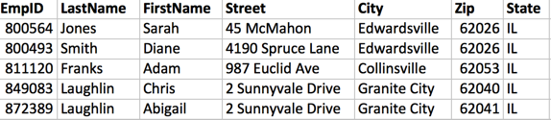
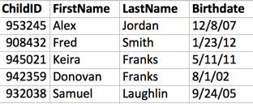
Associative entities
EmpID | ChildID | AddDate | DropDate
849083 | 932038 | 9/24/2005 | 5/2/2010
872389 | 932038 | 5/2/2010
872389 | 953245 | 6/15/2010
811120 | 945021 | 5/11/2011
811120 | 942359 | 8/1/1994 | 11/30/2020
800493 | 908432 | 1/23/2012

Slide 5
Another example
STUDENT
PK | StudentID
 | LastName
 | FirstName
 | Street
 | City
 | Zip
 | State
 | Major
 | Birthdate
COURSE
PK | CourseID
 | Section
 | Term
 | Year
 | Title
 | Room

Slide 6
Fixed!
STUDENT
PK | StudentID
 | LastName
 | FirstName
 | Street
 | City
 | Zip
 | State
 | Major
 | Birthdate
COURSE
PK | CourseID
 | Section
 | Term
 | Year
 | Title
 | Room
REGISTRATION
PK | StudentID
PK | CourseID
 | DateRegistered
STUDENT
COURSE

Slide 7
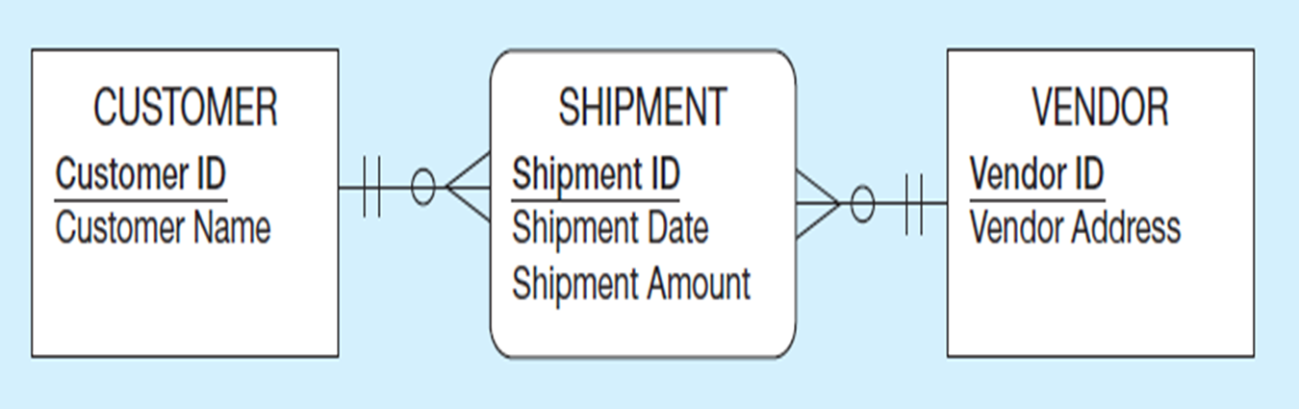
Example of Mapping an Associative Entity with an Identifier (1 of 2)
a) SHIPMENT associative entity

Slide 8
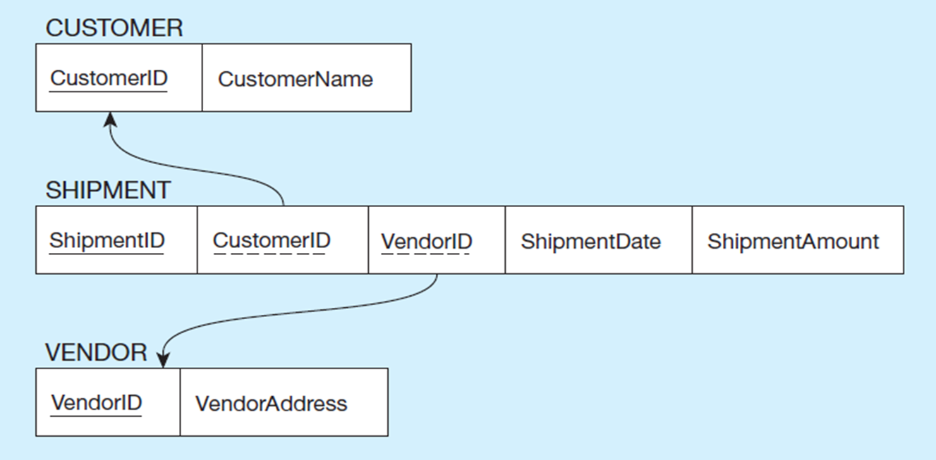
Example of Mapping an Associative Entity with an Identifier (2 of 2)
If an associative entity is created using a new identifier (primary key) we must STILL
Connect that associative entity with its related entities. These are two 1:m
Relationships, and the PK of the 1 MUST become a FK in the many.

Slide 9
To recap with foreign keys:
Mapping Binary Relationships
One-to-Many – Primary key on the one side becomes a foreign key on the many side
Many-to-Many – Create a new relation with the primary keys of the two entities as its primary key
One-to-One – Primary key on mandatory side becomes a foreign key on optional side

Slide 10
